Slide 1
CoAP: Constrained Application Protocol
黃仁竑 教授
國立中正大學資工系

Slide 2
CoAP
The Constrained Application Protocol (CoAP) is defined by IETF CoRE WG for the manipulation of resources on a device that is on the constrained IP networks.
Notes:
CoAP
- IETF CoRE WG制定了限制應用協定去運用限制IP網路上裝置的資源。

Slide 3
What CoAP is (and is not)
CoAP is
A RESTful protocol
Both synchronous and asynchronous
For constrained devices and networks
Specialized for M2M applications
Easy to proxy to/from HTTP
CoAP is not
A replacement for HTTP
General HTTP compression
Separate from the web

Slide 4
CoRE Documents
Number | Title | Date | Status
RFC 7252 RFC 7959 | The Constrained Application Protocol (CoAP) | June 2014 August 2016 | Proposed Standard
RFC 7390 | Group Communication for the Constrained Application Protocol (CoAP) | October 2014 | Experimental
RFC 7641 | Observing Resources in the Constrained Application Protocol (CoAP) | September 2015 | Proposed Standard
RFC 7650 | A Constrained Application Protocol (CoAP) Usage for REsource LOcation And Discovery (RELOAD) | September 2015 | Proposed Standard

Slide 5
Constrained IP Networks
A constrained IP network has limited packet sizes, may exhibit a high degree of packet loss, and may have a substantial number of devices that may be powered off at any point in time but periodically "wake up" for brief periods of time.
These networks and the nodes within them are characterized by severe limits on throughput, available power, and particularly on the complexity that can be supported with limited code size and limited RAM per node.
Low-Power Wireless Personal Area Networks (LoWPANs) are an example of this type of network. Constrained networks can occur as part of home and building automation, energy management, and the Internet of Things.
Source: IETF CoRE WG
Notes:
限制IP網路
一個限制IP網路有有限的封包大小，可能造成高程度的封包遺失，而且可能有大量的裝置在任何時間點被關掉但週期性地一小段時間醒來。
他們之中的網路和節點被嚴格限制的流量、可用電力和特別在可以每個節點被有限編碼大小和有限RAM支持的複雜特性所描繪。
低功率無限個人區域網路是這種類型網路的例子。限制網路可以用在家裡的一部分和建築物自動化、能源控管和物聯網上。
來源: IETF CoRE WG

Slide 6
Devices on Constrained Networks
The general architecture consists of nodes on the constrained network, called Devices, that are responsible for one or more Resources that may represent sensors, actuators, combinations of values or other information.
Devices send messages to change and query resources on other Devices.
Devices can send notifications about changed resource values to Devices that have subscribed to receive notification about changes.
A Device can also publish or be queried about its resources.
Source: IETF IPv6 WG
Notes:
限制網路上的裝置
普遍的架構包含包含被稱作裝置的限制網路節點，負責其他一個或更多代表感應器、驅動器的資源。
裝置送訊息去改變和詢問其他裝置上的資源。
裝置可以送訂閱接收改變通知的裝置通知。
裝置可以發佈或被詢問他的資源。

Slide 7
Application Scope of CoAP
CoAP targets the type of operating environments defined in the ROLL and 6LOWPAN working groups which have additional constraints compared to normal IP networks, but the CoAP protocol will also operate over traditional IP networks.
This includes applications to monitor simple sensors (e.g. temperature sensors, light switches, and power meters), to control actuators (e.g. light switches, heating controllers, and door locks), and to manage devices.
Source: IETF IPv6 WG
Notes:
CoAP的應用範圍
CoAP
這包含應用程式去監測簡單的感測器(如溫度計、燈的開關和電錶)，去控制驅動器(如燈的開關、熱度控制器和門鎖)，且去管理裝置。

Slide 8
CoAP vs. HTTP
Like HTTP, the CoAP is a way of structuring REST communications but optimized for M2M applications.
TCP and HTTP are considered too heavy for 6LowPAN devices such as sensors. CoAP is thus based on UDP and a compressed simplified message exchange.
Notes:
CoAP、HTTP 比較
如HTTP，CoAP是一個為了M2M應用而最佳化的建構REST通訊方法。
TCP和HTTP被認為對於6LowPAN裝置如感測器而言太過厚重，CoAP因此建構在UDP和壓縮且簡化後的訊息交換。

Slide 9
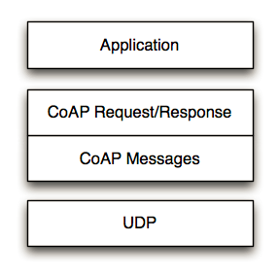
CoAP RESTful Applications
Source: IETF IPv6 WG
Notes:
CoAP RESTful 應用

Slide 10
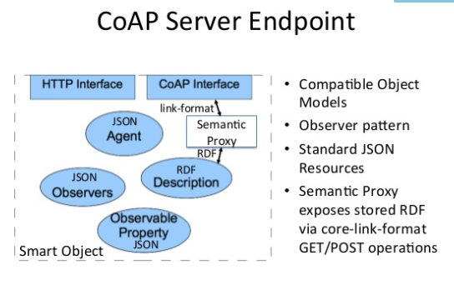
CoAP Server
https://www.slideshare.net/michaeljohnkoster/object-models-for-interoperability
Notes:
RDF stands for Resource Description Framework

Slide 11
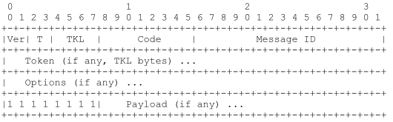
CoAP Message Format
Ver - Version (1) 2-bit
T - Transaction Type 2-bit
CON (0) – Confirmable
NON (1) – Non-Confirmable
ACK (2) – Acknowledgement
RST (3) – Reset
Token Length (TKL): 4-bit
Code – 3-bit class, 5-bit detail ("c.dd“)
Class: request (0), success response (2), client error response (4), server error response (5) (see next page for details)
Message ID - Identifier for matching responses
Token - used to correlate requests and responses.
Notes:
CoAP 訊息標準
Ver : 版本
T : 執行類型
- CON : 可確認的
- NON : 不可確認的
- ACK : 回復確認
- REST : 重置
OC : 選擇數，這個標頭之後的選擇個數
Code : 要求方法(1-10)或回應碼(40-255)
Message ID : 用做配對回復的識別符

Slide 12
CoAP Code and Message ID
Code: compressed from HTTP text representation (3 numbers) into one byte
HTTP requests =>first 3 bits 000; next five bits 0~32 (1: GET; 2: POST; 3:PUT; 4:DELETE etc.)
HTTP responses=>first 3 bits 001-101 (1~5) representing the first number of 2xx: success, 4xx: client error, 5xx: server error; xx represented by next five bits 00001~01111 (1~15 used only; e.g. with HTTP response 201 is represented as 010-00001; HTTP response 400 is represented as 100-00000 etc.)
Message ID: used in the acknowledgment process to tie a request with a response.
Notes:
CoAP 碼和訊息ID
碼 : 從HTTP 文字表達(3碼)壓縮到一個位元組
- HTTP 要求 => 第一個三位元000; 下一個五位元0~32(1:GET, 2:POST, 3:PUT, 4:DELETE …等等)
- HTTP 為應 => 第一個三位元001-101(1~5)表示1xx的第一個數字:資訊的，2xx:成功，3xx:充新導向，4xx:客戶端錯誤，5xx:伺服器錯誤，其中xx由下五位位元表示。 0001~0111(只有1~15被使用)，舉例來說HTTP回復201由010-00001代表，HTTP回復400由100-0000代表等等。
訊息 ID : 被使用在綁一個要求到回應的確認程序

Slide 13
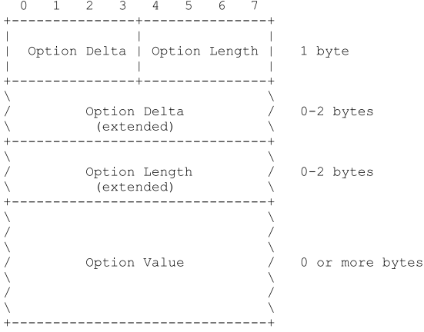
CoAP Options
Option Delta - Difference between this option type and the previous
Length - Length of the option value (0-270)
Value - The value of Length bytes immediately follows Length
Notes:
CoAP 選擇
Option Delta – 這個選擇類型和先前的差異
Length – 選擇值的長度(0-270)
Value – 緊接長度後面的長度位元組值

Slide 14
Options
CoAP defines a single set of options that are used in both requests and responses:
Content-Format
ETag
Location-Path
Location-Query
Max-Age
Proxy-Uri
Proxy-Scheme
Uri-Host
Uri-Path
Uri-Port
Uri-Query
Accept
If-Match
If-None-Match
Size1

Slide 15
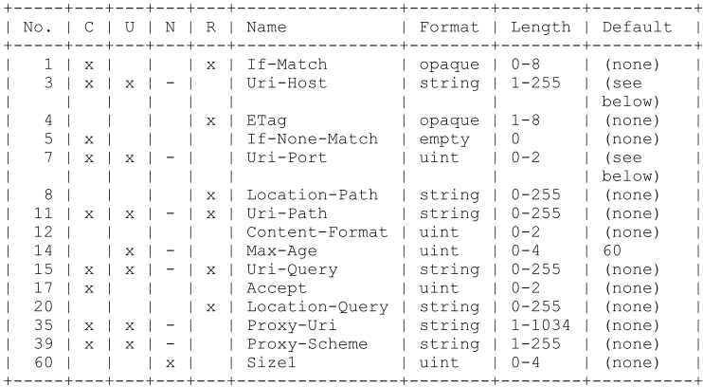
Examples of Option types
C=Critical U=Unsafe N=NoCacheKey R=Repeatable
4 (Etag) entity tag: proxy can assign entity tags to responses it sends to a client
14 (Max-Age) gives the maximum duration in seconds for which the answer may
be cached.
19 (Token) is used to match a response with a request.
6 (Observe) is used to receive regularly updated values from the server.
RFC 7641: Observing Resources in CoAP.
23, 27 (Block2, Block1) is used to transfer blocks of responses (Work in Progress)
Notes:
選擇類型的例子
1 (Content-Type) 是關於描述承載區塊語法的多用途網路郵件擴展值，舉例來說，0: test/plain，44: application/soap+xml
2 (Max-Age) 在回答被快取的幾秒間給最大值
4 (Etag)
10 (Observe) 被用在接受伺服器規律地更新值
11 (Token) 被用在要求和回復的配對
16 (Block) 被用再傳送回應的區塊
在典型用法中，當一個URL被請求，Web伺服器會返回資源和其相應的ETag值，它會被放置在HTTP的「ETag」欄位中：
ETag: "686897696a7c876b7e"
然後，客戶端可以決定是否緩存這個資源和它的ETag。以後，如果客戶端想再次請求相同的URL，將會發送一個包含已保存的ETag和「If-None-Match」欄位的請求。
If-None-Match: "686897696a7c876b7e"

Slide 16
CoAP Methods
CoAP makes use of GET, PUT, POST, and DELETE methods in a similar manner to HTTP.
New methods can be added, and do not necessarily have to use requests and responses in pairs.
For example: OBSERVE

Slide 17
CoAP URI
coap-URI = "coap:" "//" host [ ":" port ] path-abempty [ "?" query ]
coap://example.com:5683/˜sensors/temp.xml
coap://EXAMPLE.com/%7Esensors/temp.xml
coaps-URI = "coaps:" "//" host [ ":" port ] path-abempty [ "?" query ]

Slide 18
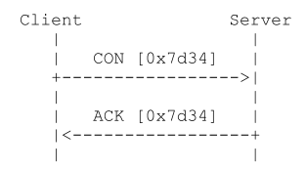
Messaging Model
Reliable Message Transmission:
Reliability is provided by marking a message as Confirmable (CON).
A Confirmable message is retransmitted using a default timeout and exponential back-off between retransmissions, until the recipient sends an Acknowledgement message.
Notes:
T - Transaction Type 2-bit
CON (0) – Confirmable
NON (1) – Non-Confirmable
ACK (2) – Acknowledgement
RST (3) – Reset

Slide 19
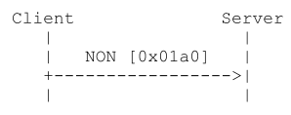
Messaging Model
Unreliable Message Transmission:
A message that does not require reliable transmission can be sent as a Non-confirmable message (NON).
These are not acknowledged.
Notes:
T - Transaction Type 2-bit
CON (0) – Confirmable
NON (1) – Non-Confirmable
ACK (2) – Acknowledgement
RST (3) – Reset

Slide 20
Example 1 of CoAP Requests
Synchronous Message Exchange
A CONfirmable message followed
by ACKowledgement piggybacked
with the response in the same
Message ID (MID).
2. When ACKnowledgment was
lost, Client’s timer expires and
it resends the message.
3. Exponential back-off between
retransmissions.
Source: M2M Communications: A Systems Approach, Wiley, 2012
Notes:
CoAP要求的例子一
同步訊息交換
一個可確認的訊息用相同訊息ID在回應夾帶的回應回覆之後。
當回應回復遺失，客戶端的計時過期它重送訊息。

Slide 21
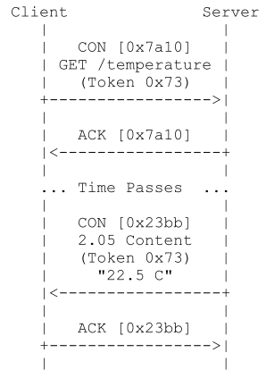
Example 2a of CoAP Requests
Asynchronous Message Exchange
A CONfirmable message with TOKEN
option can be acknowledged immediately
with an Empty Acknowledgement.
2. When the response is available,
it can be returned in a new CON
message with the same TOKEN
ID.
Notes:
CoAP要求的例子二
非同步訊息交換
1. 一個有標記選項可確認的訊息可以馬上被通知收到不用回覆。
2. 當回覆是可使用的，它可以以相同標誌ID的新的CON訊息回傳

Slide 22
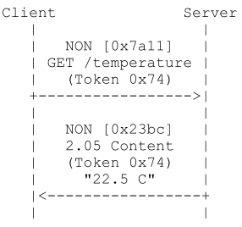
Example 2b of CoAP Requests
Asynchronous Message Exchange
A Non-confirmable message with TOKEN
then the response is sent using a new
Non-confirmable message, although the
server may instead send a Confirmable
message.
Notes:
CoAP要求的例子二
非同步訊息交換
1. 一個有標記選項可確認的訊息可以馬上被通知收到不用回覆。
2. 當回覆是可使用的，它可以以相同標誌ID的新的CON訊息回傳

Slide 23
Example 3a of CoAP Requests (OBSERVE)
Periodic response from a server
A CONfirmable message from the client
contains OBSERVE option asking periodic
responses from the server.
2. The server send NON responses with the
same TOKEN ID.
3. OBSERVE is the response will be increased to
indicate the order of the response.
4. The client will ignore OBSERVE=20 since
it arrives later than OBSERVE=30.
5. Either client or server can terminate the
process.
Source: M2M Communications: A Systems Approach, Wiley, 2012
Notes:
CoAP要求的例子三
伺服器週期地回復
1. 一個來自客戶端可確認的訊息包含從伺服器詢問周期性回覆的OBSERVE選項。
2. 伺服器用相同TOKEN ID送NON回復。
3. OVSERVE是個將由增加指出順序的回覆。
4. 客戶端將忽略OVSERVE=20當它比OVSERVE=30晚到的時候。
5: 客戶端或伺服器都可以結束行程。

Slide 24
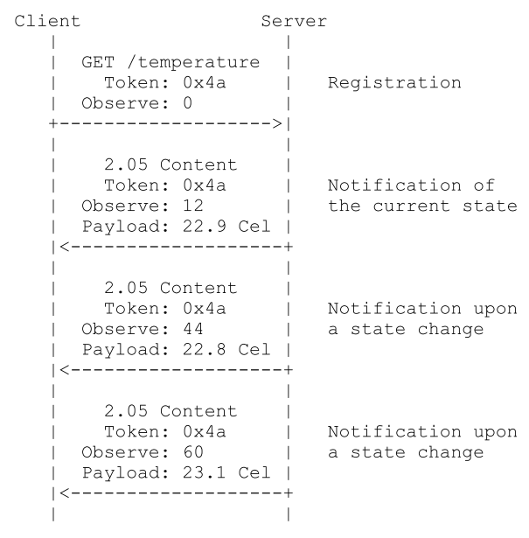
Example 3b of CoAP Requests (OBSERVE)
A notification can be confirmable or non-confirmable.
The server may send a notification in a confirmable CoAP message to request an acknowledgement from the client.
Notes:
CoAP要求的例子三
伺服器週期地回復
1. 一個來自客戶端可確認的訊息包含從伺服器詢問周期性回覆的OBSERVE選項。
2. 伺服器用相同TOKEN ID送NON回復。
3. OVSERVE是個將由增加指出順序的回覆。
4. 客戶端將忽略OVSERVE=20當它比OVSERVE=30晚到的時候。
5: 客戶端或伺服器都可以結束行程。

Slide 25
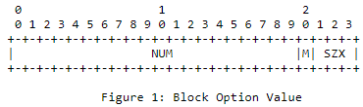
Example 4 of CoAP Requests
Source: IETF IPv6 WG
Block Transfer from Server to Client
A CONfirmable message from Client to get information.
2. Server indicates it has block of information to send.
3. Client then asks for more blocks of information.
Notes:
CoAP要求的例子四
從伺服器到客戶端的區塊傳輸
由從客戶端來的可確認訊息去取得資訊。
伺服器指出它有區塊的資訊要送。
客戶端之後要求更多區塊的資訊。

Slide 26
Proxying and Caching
Within 30s
Source: IETF IPv6 WG
Notes:
代理和快取

Slide 27
CoAP Caching Model
Cacheability determined by response code
• Freshness model
– Max-Age option indicates cache lifetime
• Validation model
– Validity checked using the Etag Option (http://en.wikipedia.org/wiki/HTTP_ETag)
Cacheability of CoAP responses depends on the Response Code.
Notes:
CoAP 快取模組
回覆碼決定可快取能力
新鮮的模組
最大年齡選項指出快取的生命週期
確認的模組
用Etag選項做正確性檢查
(http://en.wikipedia.org/wiki/HTTP_ETag)

Slide 28
CoAP Resource Discovery
Resource Discovery with CoRE Link Format
Discovering the links hosted by CoAP servers
GET /.well-known/core
Returns a link-header style format based on RFC5988 including URL, relation, type, interface, content-type etc.
See RFC 6690: Constrained RESTful Environments (CoRE) Link Format
coap://224.0.1.187/oc/core?rt=alpha.light
Notes:
CoAP 資源探索
用CoRE連結形式做資源探索
探索CoAP伺服器為本地端的連結。
GET /.well-known/core 。
回傳一個架構在RFC5988連結標頭形式包括URL、關係、類型、介面、內容類型等等。
看draft-ietf-core-line-format。

Slide 29
RFC 6690 Link Format
Link = link-value-list
link-value-list = [ link-value *[ "," link-value ]]
link-value = "<" URI-Reference ">" *( ";" link-param )
link-param = ( ( "rel" "=" relation-types )
/ ( "anchor" "=" DQUOTE URI-Reference DQUOTE )
/ ( "rev" "=" relation-types )
/ ( "hreflang" "=" Language-Tag )
/ ( "media" "=" ( MediaDesc
/ ( DQUOTE MediaDesc DQUOTE ) ) )
/ ( "title" "=" quoted-string )
/ ( "title*" "=" ext-value )
/ ( "type" "=" ( media-type / quoted-mt ) )
/ ( "rt" "=" relation-types )
/ ( "if" "=" relation-types )
/ ( "sz" "=" cardinal )
/ ( link-extension ) )

Slide 30
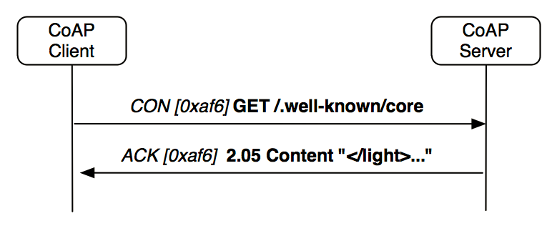
Example of Resource Discovery
</light>;rt="Illuminance";ct=0,
</s/maastr.xml>;title="Maastricht weather";ct=1,
</s/maastr/temp>;title="Temperature in Maastrich";ct=1,
</s/oulu.xml>;title="Oulu weather";ct=1,
</s/oulu/temp>;title="Temperature in Oulu";ct=1,
</s/temp>;rt="Temperature";ct=0
Source: IETF IPv6 WG
Resource Type ‘rt’ Attribute
Interface Description ‘if’ Attribute
Notes:
資源探索的例子

Slide 31
Example of Resource Discovery
REQ: GET /.well-known/core
RES: 2.05 Content
</sensors/temp>;if="sensor",
</sensors/light>;if="sensor“
REQ: GET /.well-known/core
RES: 2.05 Content
</sensors>;ct=40
REQ: GET /sensors
RES: 2.05 Content
</sensors/temp>;rt="temperature-c";if="sensor",
</sensors/light>;rt="light-lux";if="sensor"
Source: IETF IPv6 WG
Notes:
資源探索的例子

Slide 32
Summary
CoAP is applicable to any IP networks.
Open source software available for these protocols.
http://coapy.sourceforge.net/index.html
CoAPy: Constrained Application Protocol in Python
Notes:
總結
我們介紹了四個IoT/M2M應用重要的IP協定
IPv6
6LoWPAN
RPL
CoAP
6LoWPAN,RPL和CoAP特別用在LLN的802.15.4類型; 然而CoAP對於任何IP網路也是可使用的
這些協定開放原始碼軟體可使用

Slide 33

Q&A

